Slide 1
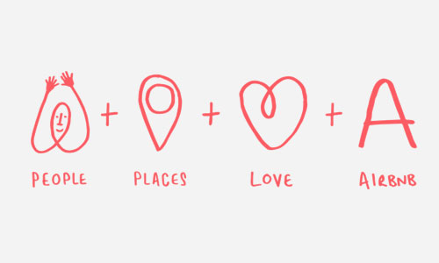
Predicting Airbnb Listing Price in Austin Metro
MIS S381N
Group 13 | Arjun Rao, Jenny Tseng, Kelly Zhang, Grant Zhong
August 2019

Slide 2
Project Goal
We explored data on >1300 Airbnb listings in the Austin area to identify the appropriate pricing mechanism for a given listing
Original columns
Modified columns
Avg rate/night ($)
Bedroom count
City
Date of listing
Listing month
Listing year
Title
Title word count
Description
Description word count
Zipcode
URL
Avg rate/night ($)
Bedroom count
City
Date of listing
Title
Description
Latitude
Longitude
URL
Along with the word count, we also identified keywords in the descriptions
Note: Data obtained from Kaggle
Notes:
The listings were made between 2010 and the first half of 2017 (total was >1800, but there were duplicates)
The ultimate goal is to help wannabe Airbnb hosts to determine the competitive price to list their homes at
Avg rate/night is by listing – a host can choose to change rates at different points in time; the dataset we found has the avg rate throughout each listing life
We modified the columns we have to obtain as much information out of the data at hand – not just to help predict optimal listing price, but also to analyze interesting patterns in the listings
Questions we wanted to answer
The ultimate one: Based on the number of bedrooms a listing has and its location, what is the market price to list the property at? Do title and description length affect pricing? What words in the description may affect pricing?
Ancillary: How has the amount of listing changed over time?

Slide 3
Summary statistics
All numeral data appear to have long right tails, especially with average rate
 | Avg rate ($) | Bedroom count | Title word count | Description word count
count | 1362.000000 | 1362.000000 | 1362.000000 | 1362.000000
mean | 159.265786 | 1.522761 | 5.646109 | 57.220264
std | 278.880700 | 1.132576 | 1.957938 | 54.560376
min | 16.000000 | 0.000000 | 1.000000 | 1.000000
25% | 50.000000 | 1.000000 | 4.000000 | 37.000000
50% | 90.000000 | 1.000000 | 6.000000 | 47.000000
75% | 150.000000 | 2.000000 | 7.000000 | 73.000000
max | 4500.000000 | 10.000000 | 12.000000 | 902.000000
Notes:
The average listing in Austin is about $159, for 1-2 rooms. However, the long tails, especially for average rates, may be problematic for our predictions.

Slide 4
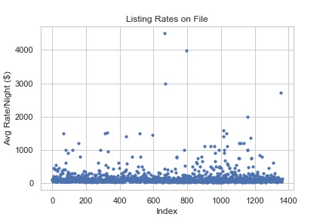
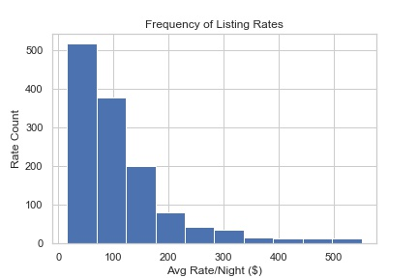
Rate frequency
We visualized the potential “outliers” in average rates and decided to exclude all listings with rates over two standard deviations above the mean
Notes:
From a quick scatter plot (left), one can see that there are a few listings that are way above the average listing price. As such, we limited our dataset to those within 2 stdev of the average pricing to prevent the effect of these “outliers.”
Given that we’re trying to predict for an average Airbnb host and the dataset we have, we felt this was the best approach to ensure a more presentative and usable dataset.
Once limited, one can see a more manageable dataset / readable histogram of the average listings.

Slide 5
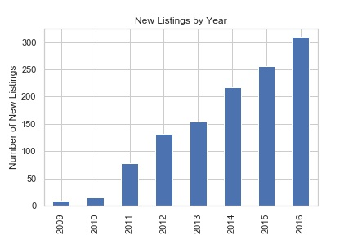
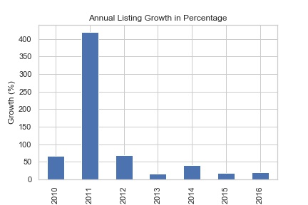
Listing growth
As an ancillary analysis, we looked at growth in the number of new listings, which was most dramatic in 2011, shortly after Airbnb’s founding in 2008
Notes:
Note we excluded the 2017 data as we only had half a year of its listings
In absolute number term, new listings continued to grow year after year; percentage wise, it’s been about the same post 2012 – although 2014 did see a bigger bump than others.
Wikipedia: Airbnb won the “app” award at the 2011 SXSW and also started expanding international that year

Slide 6
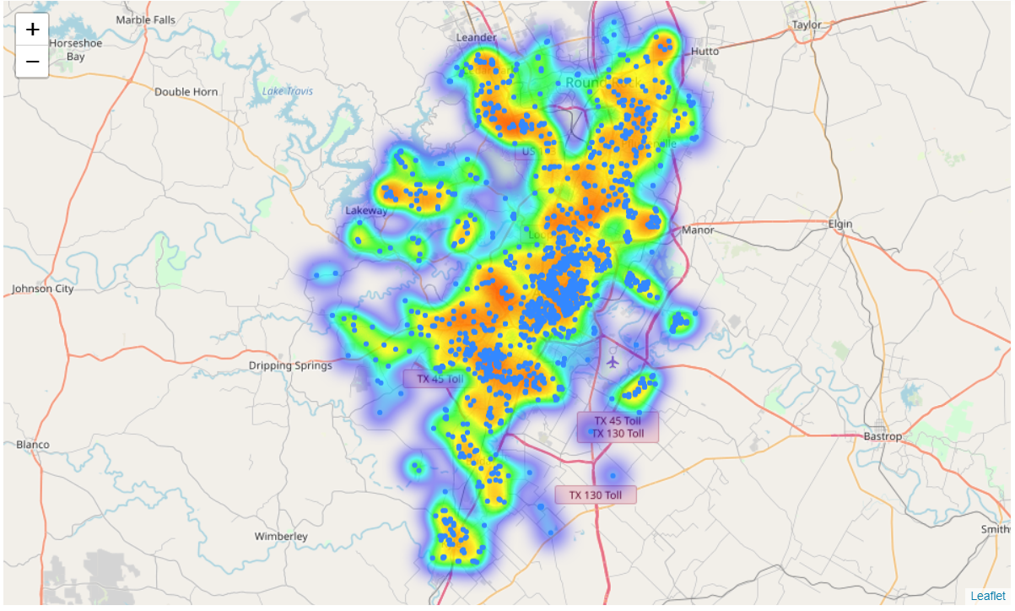
Distribution of listing locations
As expected, the listings we looked at had a concentration in the central Austin area, but there are pockets that are especially sparse in listings
Notes:
Limiting to the top 17 zip codes reduces the dataset from ~1300 to 864 listings.

Slide 7
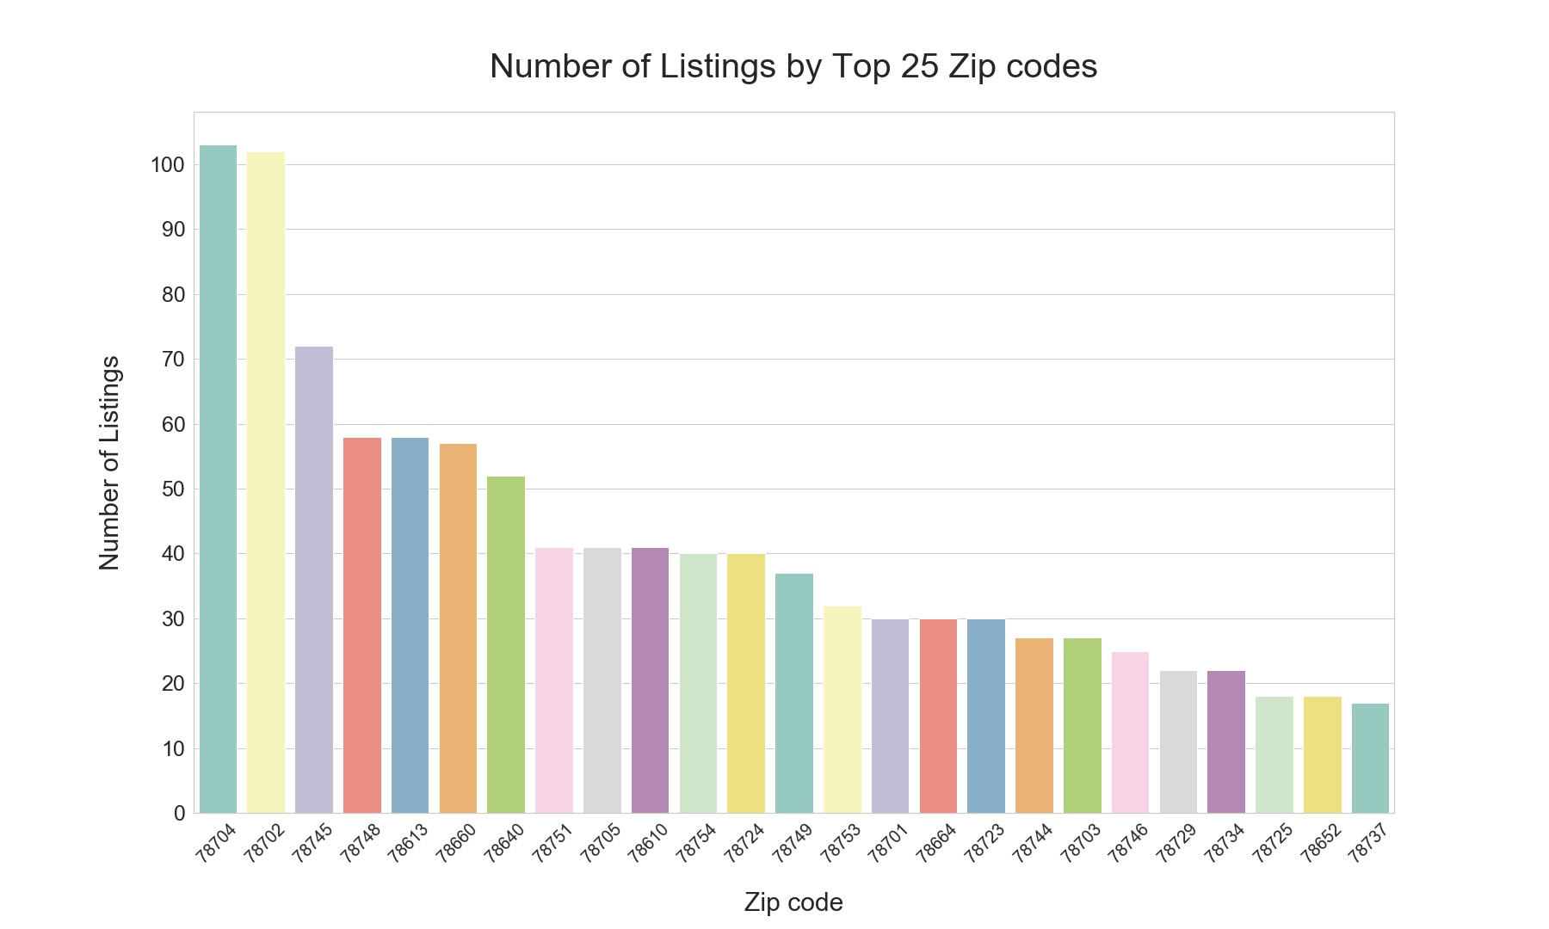
Limitation from number of listings per zip code
Upon examining the 54 zip codes in our dataset in further detail, we found many had very few listings
Zipcode | Listing count
78620 | 1
78628 | 1
78634 | 1
78642 | 1
78726 | 3
78717 | 3
78721 | 5
78739 | 6
78747 | 6
78730 | 7
78738 | 7
78728 | 7
78750 | 8
78733 | 9
78681 | 9
To ensure adequate representation in the training data, we decided to only model for zip codes that have at least 30 listings
30
Notes:
Limiting to the top 17 zip codes reduces the dataset from ~1300 to 864 listings.
Those who got excluded and look to neighboring zipcodes for expecatation

Slide 8
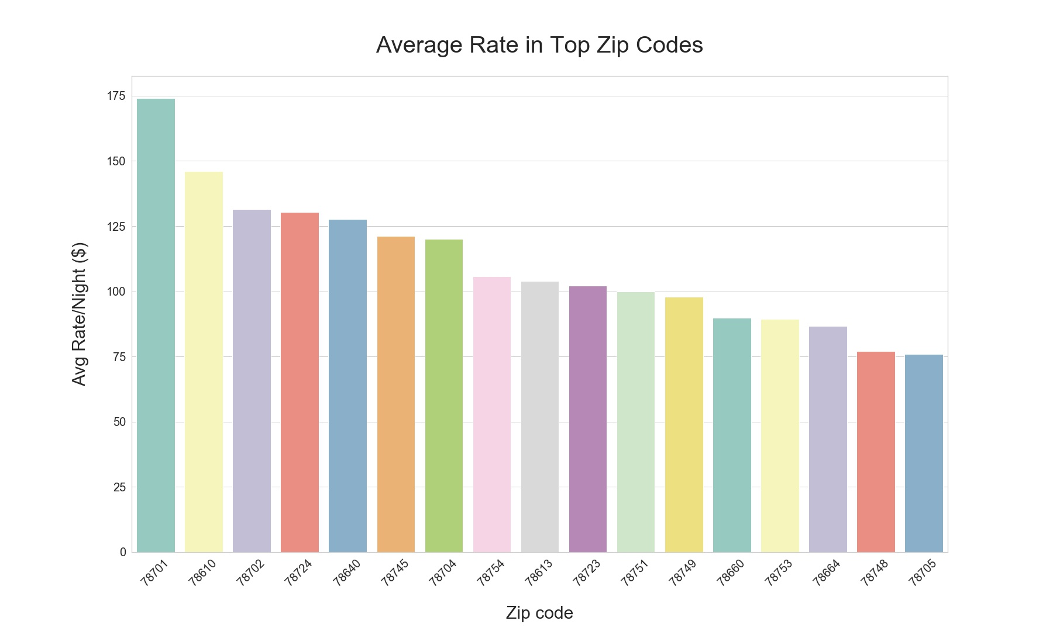
Preliminary location analysis
Before modeling, we looked at the average listing rate by zip code for initial ideas
Buda’s got some nice big houses!?
More East Austin gentrification proof
Pflugerville still in the minor league
IKEA land = cheap
Downtown = golden real estate
Ain’t nobody want to stay in West Campus
Notes:
78724: East east Austin
78640: Kyle
78745: SoCo
78613: Cedar Park
78723: Windsor Park (Mueller north)
78753: Entire north Lamar (Chinatown, Rundberg, etc.)

Slide 9
Keyword selection
We extracted some high to medium frequently used words and high TF-IDF scored words in the descriptions to incorporate into our model
Most Frequently Used Word | Mentions
austin | 1031
downtown | 744
home | 516
place | 467
private | 457
room | 434
minutes | 382
bed | 373
house | 364
2 | 360
close | 359
neighborhood | 295
bedroom | 294
located | 289
kitchen | 281
quiet | 271
miles | 268
1 | 262
restaurants | 255
Select Medium-Frequently Used Word | Mentions
Park | 217
business | 190
location | 182
love | 175
area | 174
5 | 173
15 | 168
couples | 159
coffee | 157
pool | 156
new | 154
walking | 153
apartment | 152
walk | 146
comfortable | 140
east | 137
min | 121
airport | 120
modern | 104
High TF-IDF Score Words¹ | TF-IDF Score
sleeps | 4.3287
furnished | 4.3287
breakfast | 4.3287
included | 4.3287
shared | 4.2970
cable | 4.2970
lots | 4.2970
remodeled | 4.2662
food | 4.2662
trails | 4.2662
views | 4.2662
bike | 4.2364
rainey | 4.2074
convenient | 4.2074
domain | 4.1792
small | 4.1251
king | 4.1251
floors | 4.1251
brand | 4.1251
After ranking the words, we manually chose around 10 words (bolded) from each group for modeling
Note(s): (1) For words mentioned at least 50 times in all descriptions

Slide 10
Regression results
Regressing on all variables, we found bedroom count and downtown location are the most significant predictors, while most zip codes and keywords are not important for predictions
Significant predictors¹ | coef | std err | t | P>|t|
Intercept | 39.0195 | 8.687 | 4.492 | 0
Bedroom count | 65.4884 | 2.893 | 22.639 | 0
Title word count | -3.0145 | 1.297 | -2.325 | 0.02
Zip: 78660 | -18.6277 | 8.893 | -2.095 | 0.037
Zip: 78664 | -48.9494 | 12.386 | -3.952 | 0
Zip: 78701 | 66.4393 | 12.655 | 5.25 | 0
Zip: 78702 | 29.7527 | 7.763 | 3.832 | 0
Zip: 78704 | 24.6264 | 7.564 | 3.256 | 0.001
Zip: 78748 | -26.7594 | 9.789 | -2.733 | 0.006
Keyword: “room” | -16.6514 | 6.17 | -2.699 | 0.007
Keyword: “house” | -13.5842 | 6.319 | -2.15 | 0.032
Keyword: “pool” | 26.6991 | 8.745 | 3.053 | 0.002
Keyword: “modern” | 22.4519 | 9.986 | 2.248 | 0.025
Key
Increases average rate
Decreases average rate
Pflugerville
Round Rock
Downtown
East Austin
SoCo
S. Austin
Metrics
R² before / after cutting | 0.557 / 0.531 (0.520 / 0.523 Adj)
RMSE | $111
Insignificant predictors
Description word count
The remaining 11 zip codes
The remaining 30 keywords
Note(s): (1) Significant at 5% level
Notes:
Briefly describe modeling approach :
Set up the dummy variables for zip code and keywords
Splitting data into training/test, 80/20
Fit model on train
Predict on test and get RMSE
Explain what increases / decreases
Intercept: Holding everything constant, if you list, you start at this price
Bedroom understandably is very significant
Title world count has slight significance; people don’t want to read too much, but probably doesn’t matter all that much ($3…)
Downtown, as seen previously, is the most golden real estate
North Austin is cheap
Keywords: Pool and modern, not surprisingly, increase your price (but these are more attributes of your listing, rather than how you describe them)
Room and house for some reason decrease your price… maybe don’t say them
In general, our model explained ~50% of the listing price. Our RMSE made it evident that we’re not great at predicting the price (mean ~$159). Obviously we don’t have enough information about each listing – essentially basing predictions based off of only location and bedroom count. We started extracting more property quality more with the keywords, but that didn’t take us far enough.
Worthy to note: Our model error on the higher side (often we predicted too high)
We did a tree but the accuracy was 5% (max depth at 2)
Even if the tree method is better, predict

Slide 11
Appendix

Slide 12
Title word count at a glance
Across all >1300 listings, the word counts of titles do not very much
Title Word Count | Count | Mean
1 | 5 | 247.400000
2 | 59 | 98.440678
3 | 118 | 123.779661
4 | 199 | 112.467337
5 | 264 | 106.943182
6 | 247 | 121.748988
7 | 179 | 105.402235
8 | 119 | 111.781513
9 | 78 | 122.717949
10 | 25 | 110.960000
11 | 7 | 140.000000
12 | 3 | 139.666667
Notes:
Not limited by rate stdev or listings in zip code
Description word counts vary by a lot

Slide 13
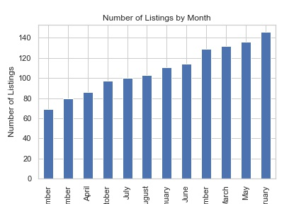
Number of listings by month
People seem to list more in the beginning of the year and less at the end
Notes:
One can assume 2009 likely had too few listings to really mean anything
However, it seems like post 2012, the new listings have lower average rates
Market getting competitive?

Slide 14
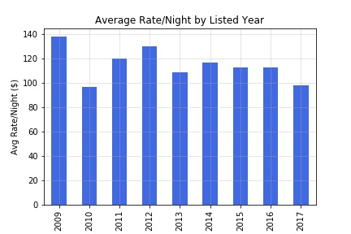
Average listing price by listed year
Interestingly, homes listed since 2013 seem to have lower average rates
Notes:
One can assume 2009 likely had too few listings to really mean anything
However, it seems like post 2012, the new listings have lower average rates
This is not necessarily meaningful as it could just be that people who have listed for longer know when to adjust their prices throughout the year better

